Slide 1


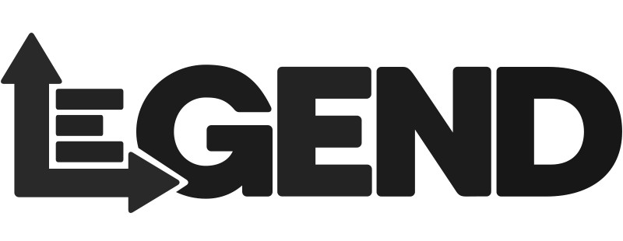

Accelerating trade cycles with open source technologies

Slide 2
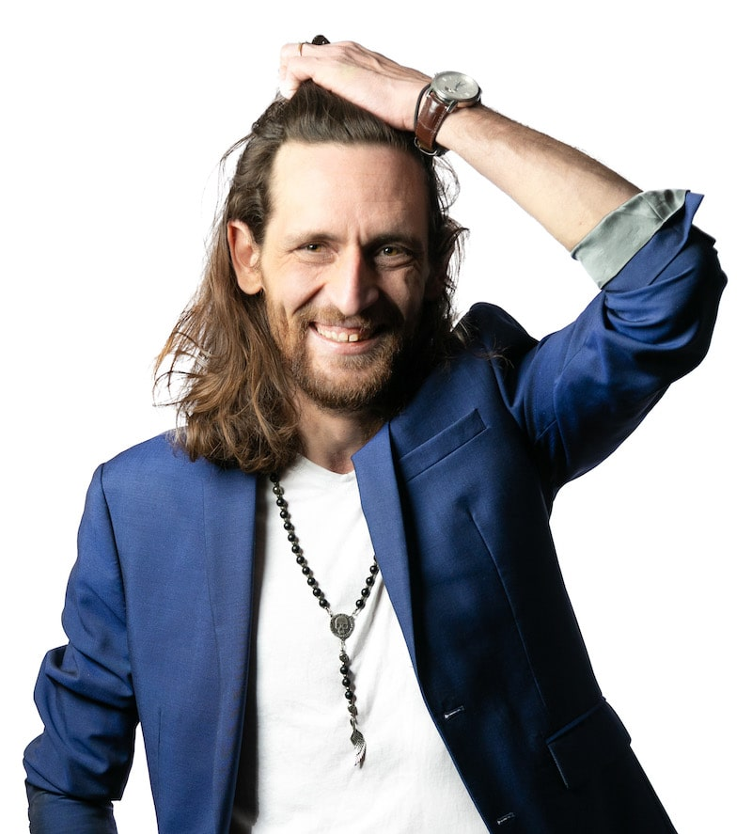

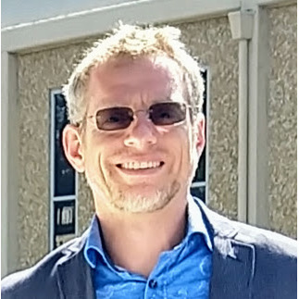

Speakers
Antoine Amend
Sr Technical Director - Databricks
Ashley Trainor
Sr Solution Architect - Databricks
Stephen Goldbaum
Distinguished Engineer - Morgan Stanley
Ephrim Stanley
Technology Fellow - Goldman Sachs

Slide 3
“Nothing Good Happens between Trade and Settle Date”
Notes:
More of an adage than a quote, we’ve seen that say in wall street when moving from T3 down to T2 back in … 2015. In 7 years, we’ve seen rise of geopolitical tensions, brexit, a global pandemic and with it the rise of retail investment, meme stocks and reddit posts, a frenzy across crypto markets.. And that explosion of data that exposed clear limitations of post trade systems to adapt, scale. Time equals risk, and reducing that time means reducing the number of trades that fall short and their associated margins.

Slide 4
Shortening Settlements Cycles
Streamlining operations through open source initiatives
Motivations
Create a frictionless system between market participants
Reduce risks for periods of high volatility, hence margins
Standards
Challenges
Back offices are known for legacy systems and data silos
Transfer of information requires tedious reconciliation
Interoperability
Solutions
Machine interpretable data and calculation
Harmonization of data across organizations
Collaboration
Notes:
Suggested by DTCC, T1 now enforced by the SEC to take place by mid 2024. That leaves us with only a year to build, integrate and test, not 1, 2, 5 systems, but an ecosystem shared with each market participant, from buy side, sell sides, custodians, clearing houses. Back offices are notoriously known for silos across regions, trading desks, and asset classes, legacy technologies, manual processes. I would not be surprised to hear some teams running from one system to another with a floppy disk or sending the same via fedex courier. Simple, we ask them to run 2 times faster now. Or we can realize that it is not about running faster, but running smarter. It’s not about lifting and shifting the existing technology to faster horses, but adopting a new behavior, a new approach to data. Allowing data, processes and calculations to be machine interpreted through simple interfaces (i.e. contracts), by connecting data modelling to data pipelines, compliance requirements to data operations, connecting business with technology. This shift is exactly in line with the core principles behind open source technologies.

Slide 5
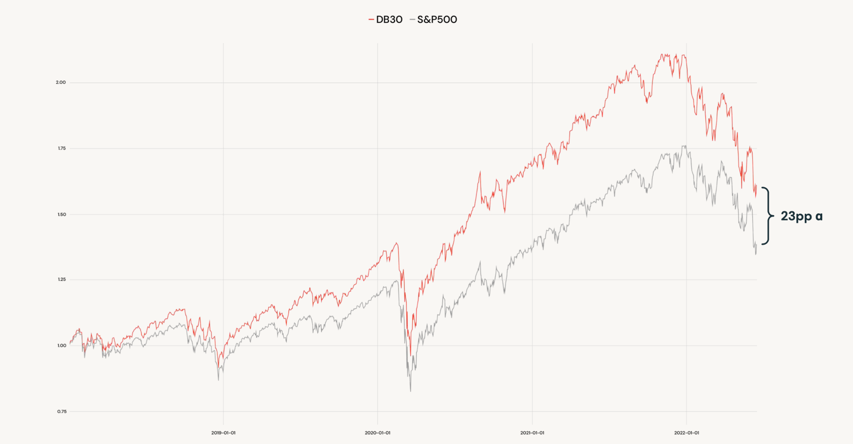
Data Culture
Organizations that focus on open source do not “just comply”, they win
Notes:
But modernizing does not just means complying. When NCC margin calls are estimated to be reduced by 40%, that’s billions of dollars that could be reinvested elsewhere should we streamline that process between back and front office. And we’ve seen that pattern over and over, open source create new opportunities. Data culture win. We’ve seen that from a MS report that stated that companies focusing on cloud, data and open source win. At databricks, being cloud, data, open source, our customers should win. And that gap widened in period of high economic volatility. Cloud, data and open source offers the opportunity to outperform, and technologies like DATABRICKS LAKEHOUSE, LEGEND, MORPHIR, contribute to that behavioral shift.

Slide 6

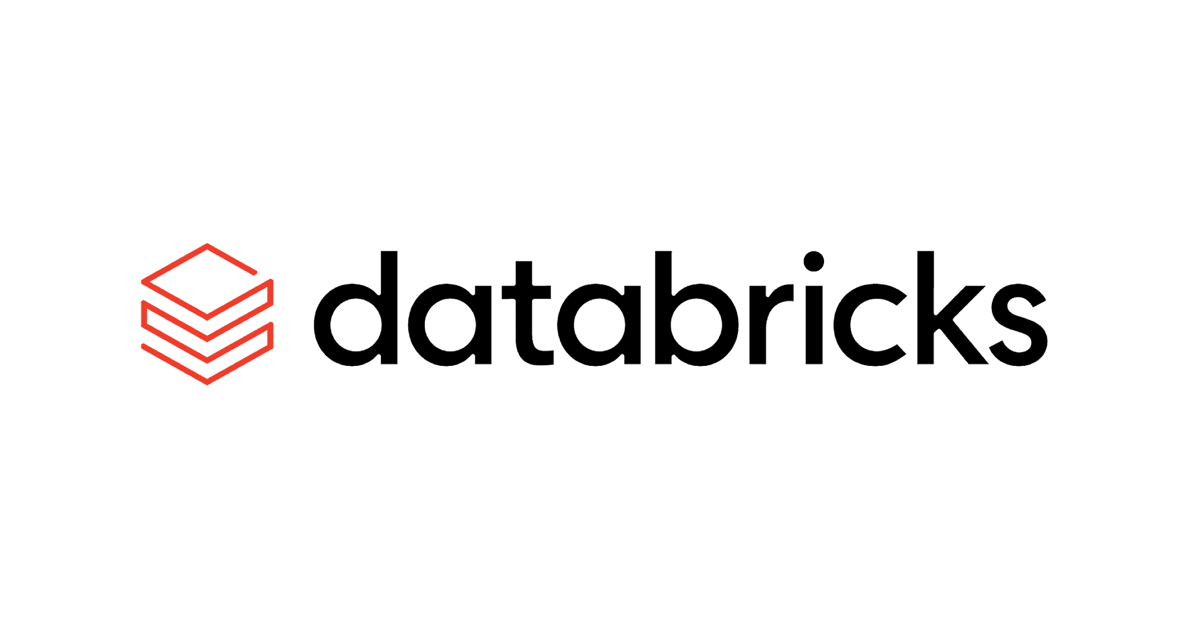

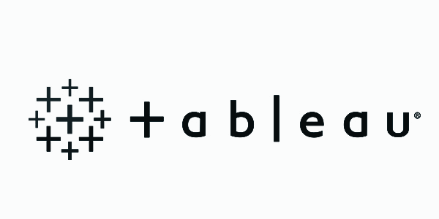
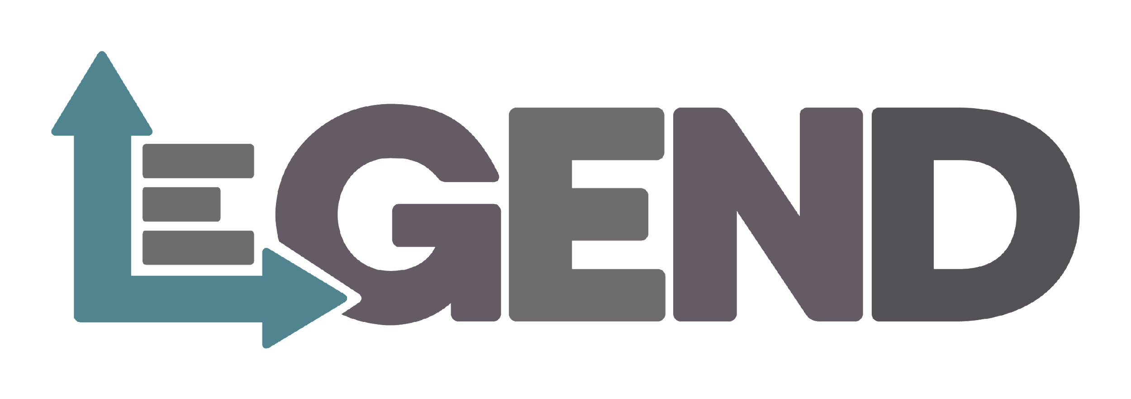
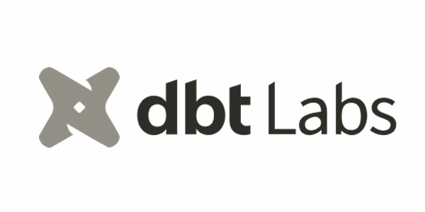

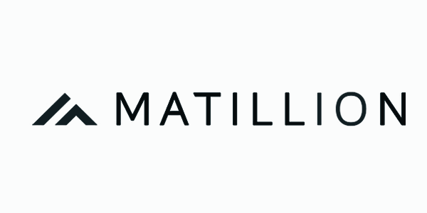
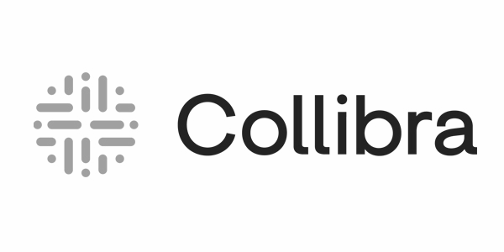
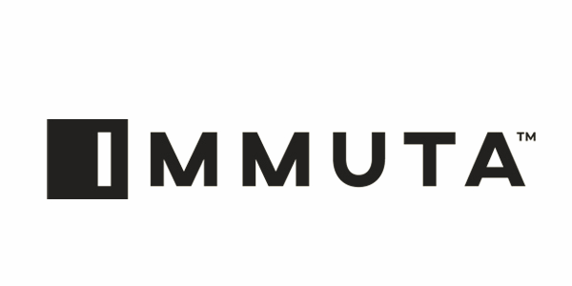



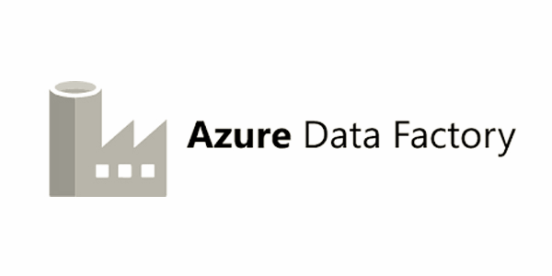

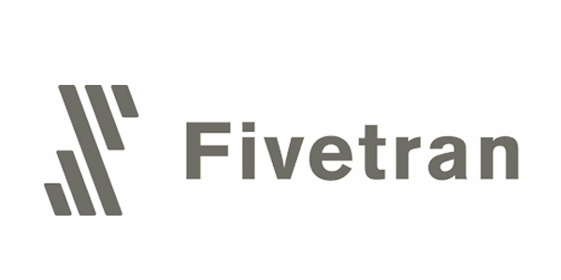
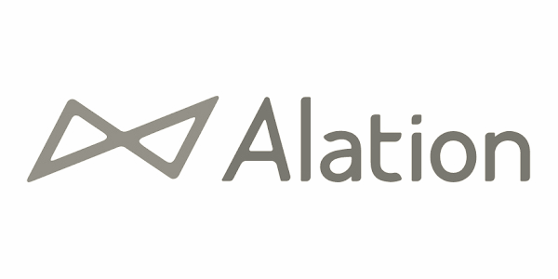

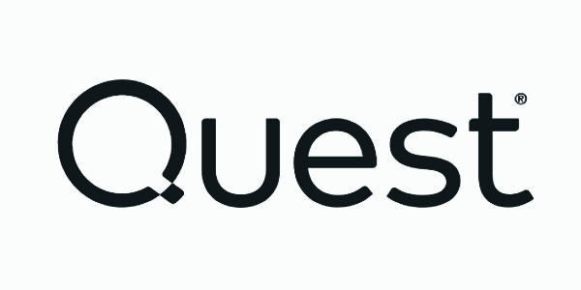

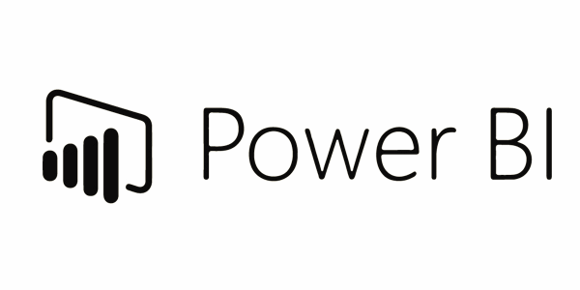





delta-io/delta
powered by
Harmonization with open data standards
Data Pipelines
Data Governance
BI & Dashboards
Data
Warehousing
Data Engineering
Data Science
and ML
Simple
Unify your data warehousing use cases on a single platform
Unity Catalog Fine-grained governance for data
Delta Lake
Data reliability and performance
Open
Built on open source and open standards
Cloud Data Lake
Multi-cloud
One consistent data platform across clouds
Notes:
Harmonization
Open data standards

Slide 7
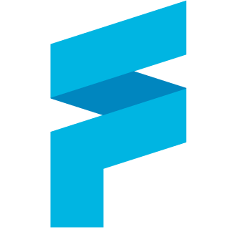
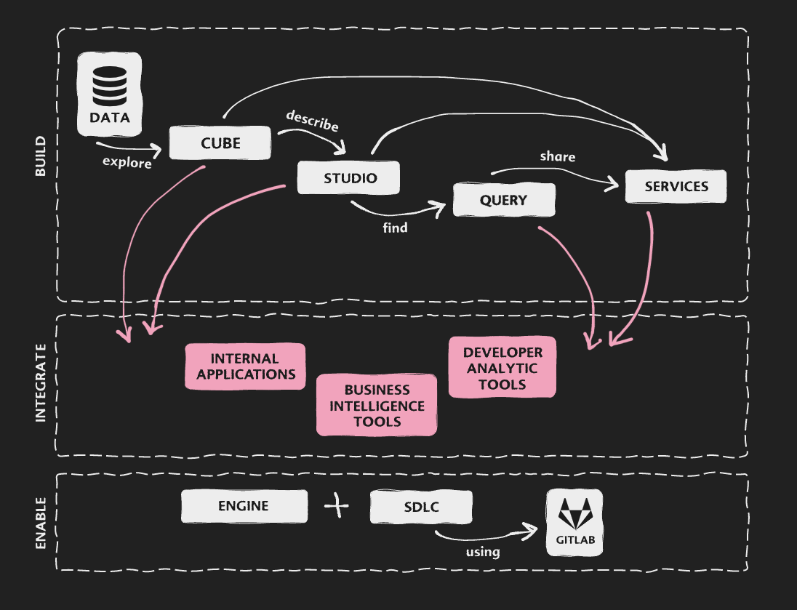
finos/legend
Data as machine interpretable models
Legend is a data modeling and management platform.
A data model is a systematic way of describing business concepts and their relationships.
Data is physically stored in databases/platforms like Databricks.
Legend enables a logical model to be mapped to the underlying physical model.
Using this mapping, Legend converts a logical query to a physical query.
This enables users to get a consistent view of the (logical) data irrespective of where (physical) data is stored.

Slide 8

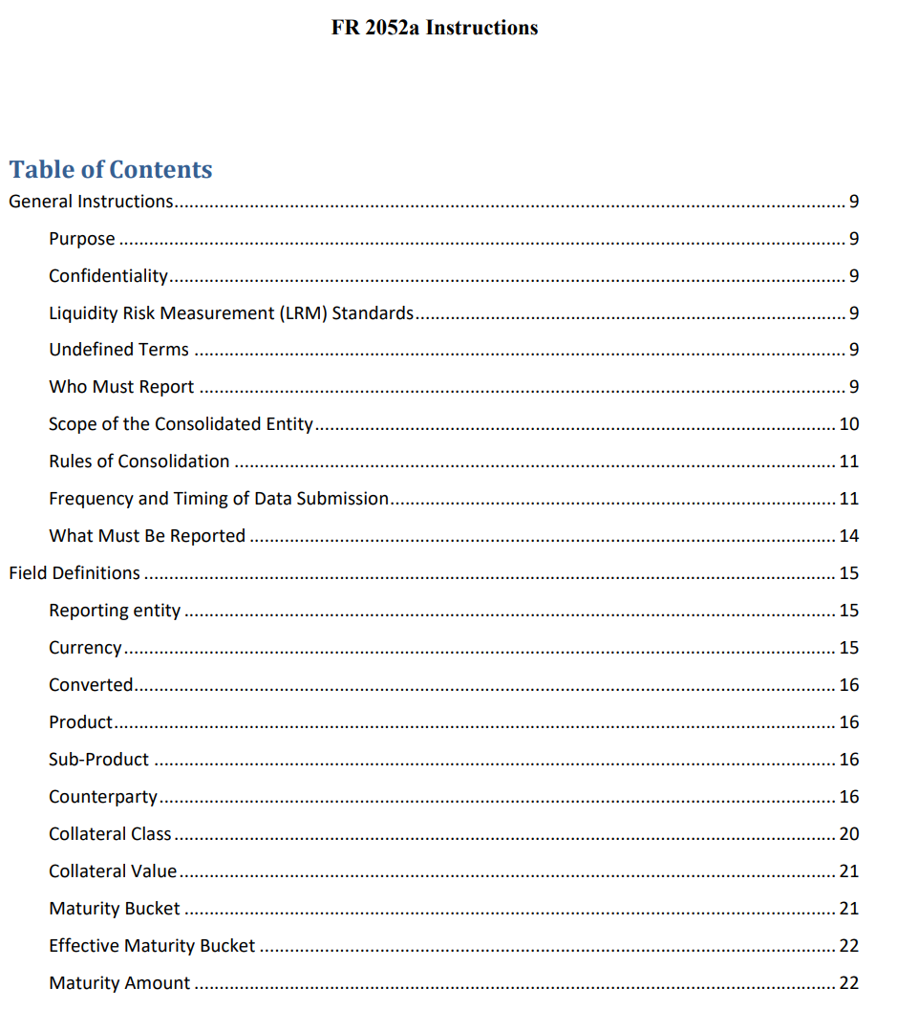
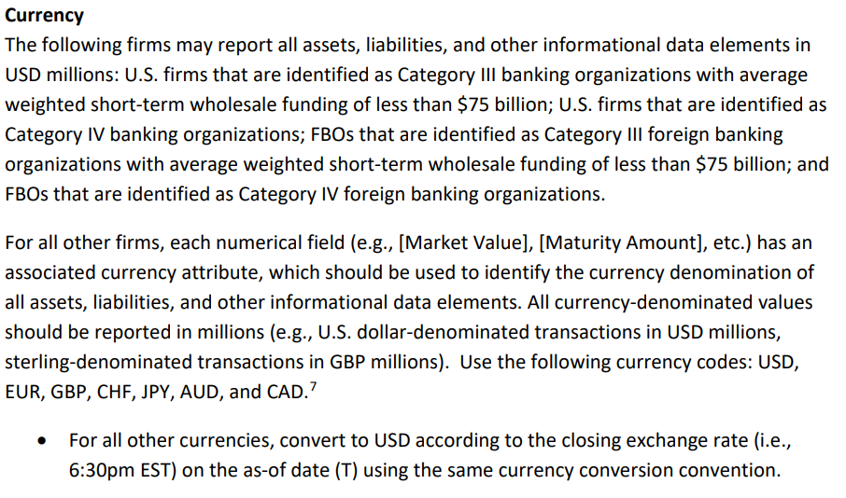
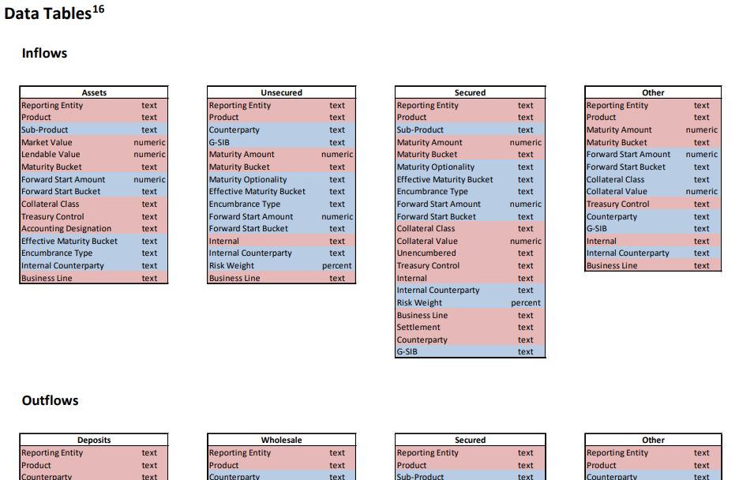
finos/morphir
Logic as a machine interpretable contract
Ensure it’s correct
Understand the whole regulation
Future proof
Collaborate across industry, vendors, and regulators
Interpret
Document
Analyze
Implement

Slide 9
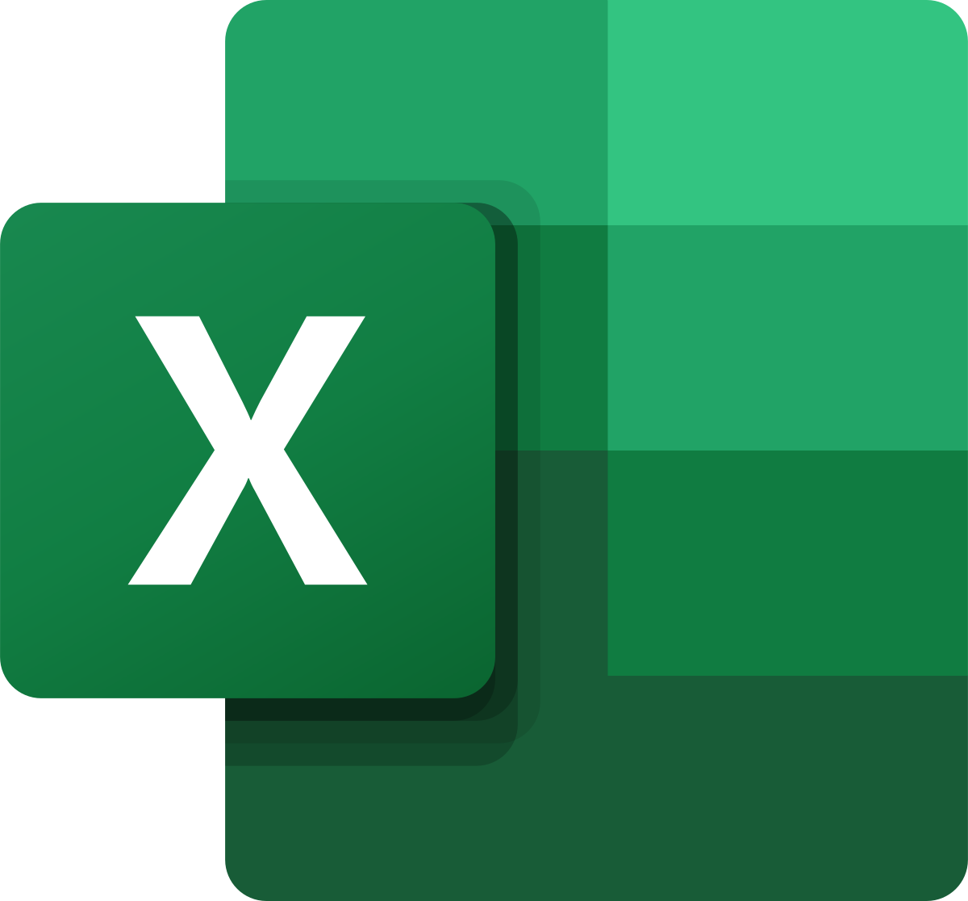
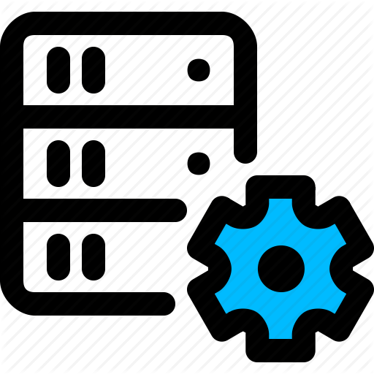

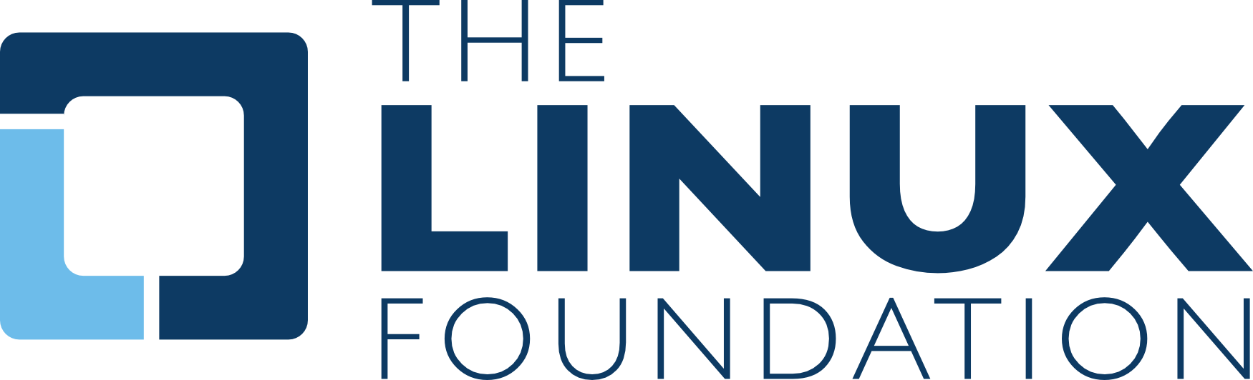

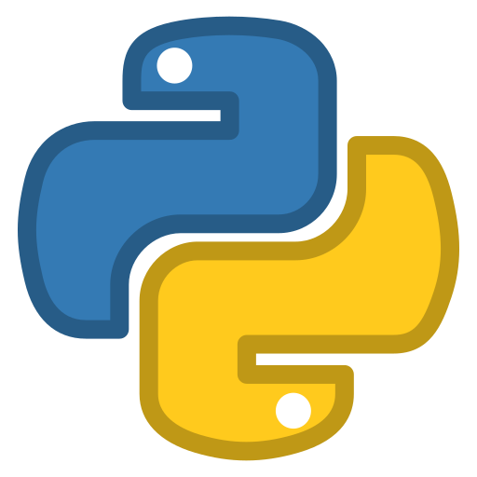
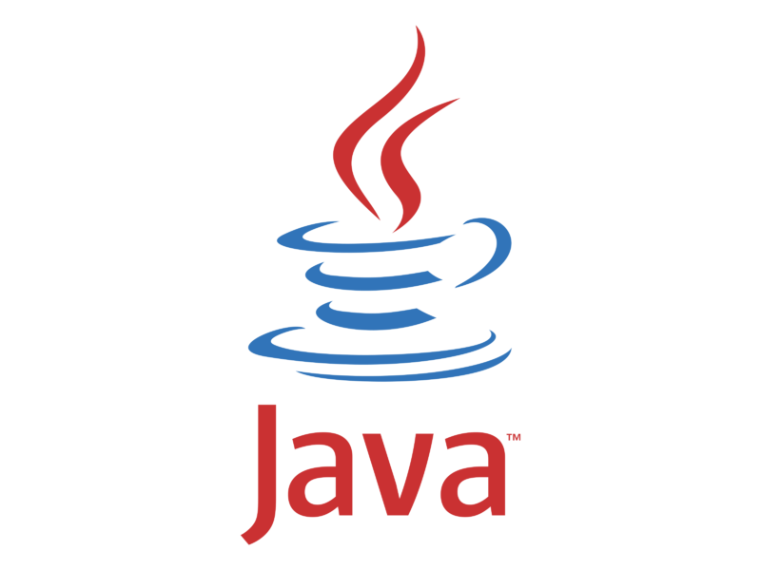


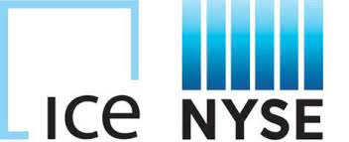


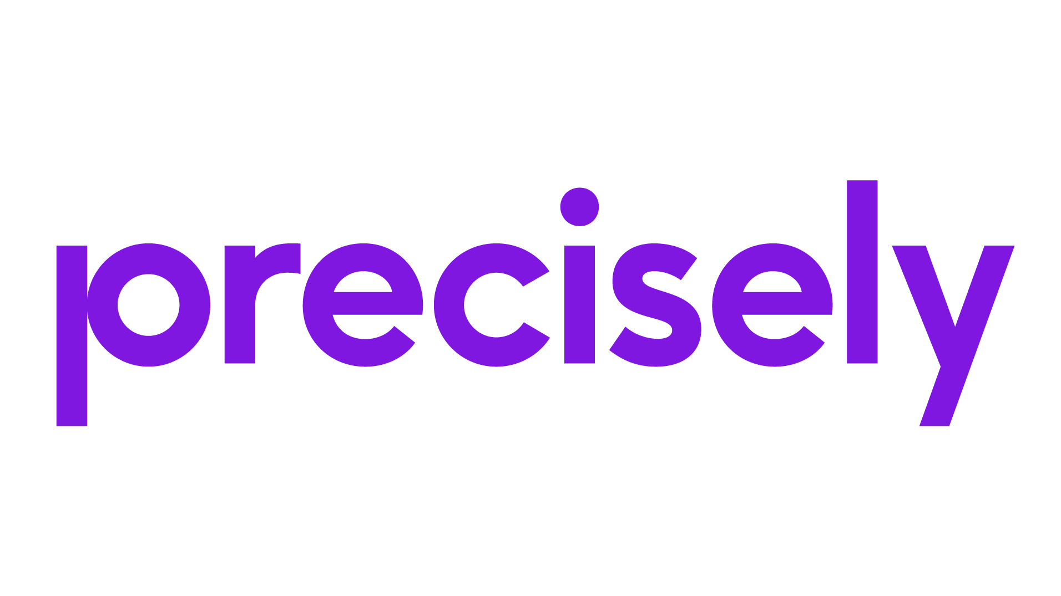
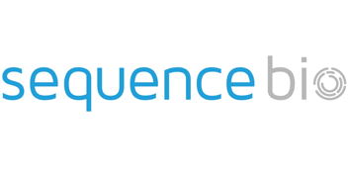




delta-io/delta-sharing
powered by
Interoperability of data and models across systems
> CREATE RECIPIENT custodian
> CREATE SHARE trades
> ALTER SHARE trades ADD TABLE derivatives
> GRANT SELECT
ON SHARE trades TO custodian
Delta Sharing on
Unity Catalog
Delta Sharing Protocol
ADLS/S3/GCS Objects
Data Providers
Notes:
Delta Sharing can future proof your sharing capabilities and reduce lock-in

Slide 10
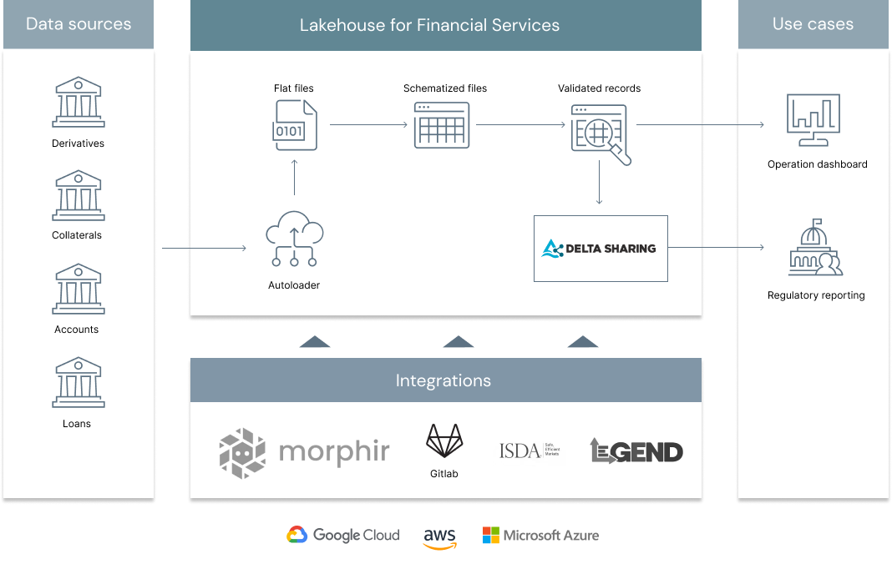
Shortening Settlements Cycles
Streamline, Automate, Iterate

